Slide 1
9.5 Equivalence Relations

Slide 2
Definition
A relation R on a set A is an equivalence relation (等价关系) iff R is
reflexive
symmetric
transitive
It is easy to recognize equivalence relations using digraphs.

Slide 3
Equivalence relations
The subset of all elements related to a particular element forms a universal relation (contains all possible arcs) on that subset. The (sub)digraph representing the subset is called a complete (sub)digraph. All arcs are present.
The number of such subsets is called the rank of the equivalence relation.

Slide 4
Examples: A has 3 elements
1
2
1
2
1
2
3
3
3

Slide 5
Equivalence class
Each of the subsets is called an equivalence class.
A bracket around an element means the equivalence class in which the element lies.
[x] = {y | (x, y) is in R}
The element in the bracket is called a representative (代表元) of the equivalence class. We could have chosen any one.

Slide 6
Example
Let A be the set of all triangles in the plane and let R be the relation on A defined as follows:
R = {(a, b) ∈ A × A | a is congruent to b}.
It is easy to see that R is an equivalence relation.

Slide 7
Example
Let A = Z and let
R = {(a, b) ∈ A × A | a and b yield the same remainder when divided by 2}.
Show
congruence mod 2 is an equivalence relation
note
2 is called the modulus
a ≡ b (mod 2)
“a is congruent to b mod 2.“(模2同余)

Slide 8
Solution, a typical way
First
clearly a ≡ a (mod 2).
Thus R is reflexive.
Second
if a ≡ b (mod 2), then a and b yield the same remainder when divided by 2, so b ≡ a (mod 2).
R is symmetric.
Finally
suppose that a ≡ b (mod 2) and b ≡ c (mod 2). Then a, b, and c yield the same remainder when divided by 2.
Thus, a ≡ c (mod 2).
R is transitive.
Hence congruence mod 2 is an equivalence relation.

Slide 9
The equivalence classes of the relation congruence modulo m are called the congruence classes modulo m.
The congruence class of an integer a modulo m is denoted by [a]_{m}, so [a]_{m} = {…, a−2m, a−m, a+2m, a+2m, … }.
Example
[0]₄ = {…, −8, −4 , 0, 4 , 8 , …}
[1]₄ = {…, −7, −3 , 1, 5 , 9 , …}
[2]₄ = {…, −6, −2 , 2, 6 , 10 , …}
[3]₄ = {…, −5, −1 , 3, 7 , 11 , …}

Slide 10

单选题
1分
Suppose that R is the relation on the set of strings of English letters such that aRb if and only if l(a) = l(b), where l(x) is the length of the string x. Is R an equivalence relation?
A
YES
B
NO
提交

Slide 11
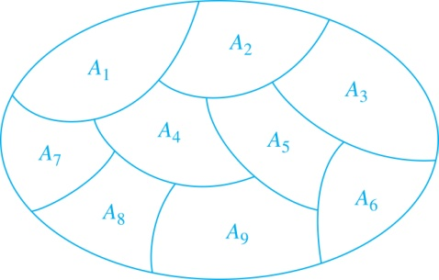
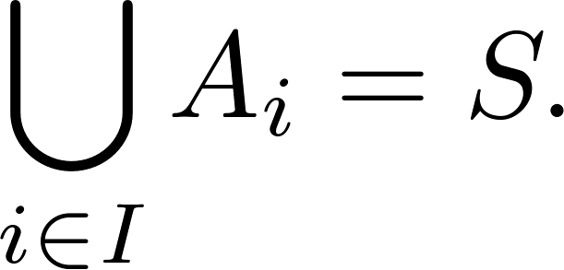
Equivalence Relations and Partitions
If P is a partition of a set A, then P can be used to construct an equivalence relation on A.
Definition: A partition of a set S is a collection of disjoint nonempty subsets of S that have S as their union. In other words, the collection of subsets A_{i}, where i ∈ I (where I is an index set), forms a partition of S if and only if
A_{i} ≠ ∅ for i ∈ I,
A_{i} ∩ A_{j}=∅ when i ≠ j,
and
A Partition of a Set

Slide 12
Theorem 1
Let P be a partition of a set A. Define the relation R on A as follows:
a R b
If and only if
a and b are members of the same block.
Then R is an equivalence relation on A.

Slide 13
Proof
If a ∈ A, then clearly a is in the same block as itself; so a R a.
If a R b, then a and b are in the same block; so b R a.
If a R b and b R c, then a, b, and c must all lie in the same block of P. Thus a R c.
Since R is reflexive, symmetric, and transitive, R is an equivalence relation.
R will be called the equivalence relation determined by P.
QED

Slide 14
Example
Let A = {1, 2, 3, 4} and consider the partition P = {{1, 2, 3}, {4}} of A. Find the equivalence relation R on A determined by P.
Solution
The blocks of P are {l, 2, 3} and {4}.
Each element in a block is related to every other element in the same block and only to those elements.
Thus R = {(1, 1), (1, 2), (1, 3), (2, 1), (2, 2), (2, 3), (3, l), (3, 2), (3, 3), (4, 4)}.

Slide 15
Lemma
Let R be an equivalence relation on a set A, and let a ∈ A and b ∈ A.
Then
a R b
if and only if
R(a) = R(b)

Slide 16
Proof of lemma
First suppose that R(a) = R(b)
Since R is reflexive, b ∈ R(b) = R(a), so a R b.
Conversely, suppose that a R b, show that R(a) = R(b)
choose x ∈ R(b)
bRx
a R b
aR x (transitive)
x ∈ R(a).
Thus R(b) ⊆ R(a)
A completely similar argument shows that, R(a) ⊆ R(b)
so R(a) = R(b)
QED

Slide 17
Theorem
Let R be an equivalence relation on A, and let P be the collection of all distinct relative sets R(a) for a in A.
Then P is a partition of A, and R is the equivalence relation determined by P.

Slide 18
Proof
P = {R(a) | a ∈ A}
Every element of A belongs to some relative set.
Since reflexivity of R, a ∈ R(a)
If R(a) and R(b) are not identical, then R(a) ∩ R(b) = ∅
If R(a) ∩ R(b) ≠ ∅ , then R(a) = R(b).
Contrapositive(换质位命题、对换式、逆反式)

Slide 19
Proof : If R(a) ∩ R(b) ≠ ∅ , then R(a) = R(b)
Let c ∈ R(a) ∩ R(b)
a R c, b R c
c R b, since R is symmetric
a R b, since R is transitive
R(a) = R(b) by Lemma l
So, P is a partition
a R b iff a and b belong to the same block of P, Thus P determines R.
QED

Slide 20
Equivalence classes
If R is an equivalence relation on A, then the sets R(a) are traditionally called equivalence classes of R, denoted by [a]
The partition P consists of all equivalence classes of R is denoted by A/R and called
the quotient set, or
the partition of A induced by R, or,
A modulo R.

Slide 21
Example
Let
A = {1, 2, 3, 4}
R = {(1, 1), (1, 2), (2, 1), (2, 2), (3, 4), (4, 3), (3, 3), (4, 4)}.
Determine A/R.
Solution
R(1) = {1, 2} = R(2)
R(3) = {3, 4} = R(4).
Hence A/R = {{1, 2}, {3, 4}}

Slide 22
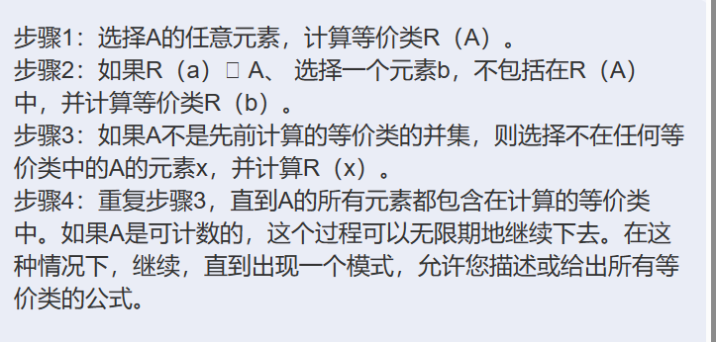
Determining partitions A/ R
STEP 1: Choose any element of A and compute the equivalence class R(a).
STEP 2: if R(a) ≠ A, choose an element b, not included in R(a), and compute the equivalence class R(b).
STEP 3: If A is not the union of previously computed equivalence classes, then choose an element x of A that is not in any of those equivalence classes and compute R(x).
STEP 4: Repeat step 3 until all elements of A are included in the computed equivalence classes. If A is countable, this process could continue indefinitely. In that case, continue until a pattern emerges that allows you to describe or give a formula for all equivalence classes.

Slide 23
Example
Let R be the equivalence relation defined in example 2, determine A/R.
Solution
R(0)={…, -6, -4, -2, 0, 2, 4, 6, …}
R(1)={…, -5, -3, -1, 1, 3, 5, 7, …}
Hence A/R consists of the set of even integers and the set of odd integers.

Slide 24
homework
§9.5
16, 56, 60, 64

